Slide 1
THE PRESENT CONTINUOUS TENSE (НАСТОЯЩЕЕ ПРОДОЛЖЕННОЕ ВРЕМЯ)
Действие , которое происходит в данный момент.

Slide 2

CONTINUOUS
ДЛИТЕЛЬНОЕ
(NOW-сейчас, в данный момент)

Slide 3
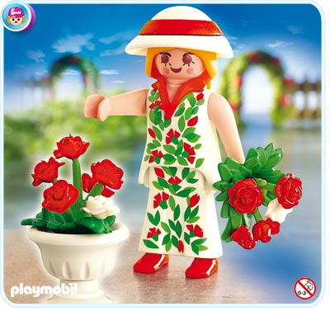
THE PRESENT CONTINUOUS TENSE
SHE IS PLANTING ROSES NOW.
(ОНА СЕЙЧАС САЖАЕТ РОЗЫ).

Slide 4
THE PRESENT CONTINUOUS TENSE
+ |  |  | ? |  |  | -
I | am | Ving | Am | I | Ving | I | am(I’m not) | Ving?
We You They | are |  | Are | We You They |  | We You They | are(aren’t)
He She It | is |  | Is | He She It |  | He She It | is(isn’t)

Slide 5
1.Преобразуй предложения, употребляя время THE PRESENT CONTINUOUS TENSE
The teacher is reading a story and the pupils are playing
Nastya is singing a song.
Is she singing in Russian?
I am putting on now.
They are not cooking now.
We are walking now.
My parents are watching TV now.

